Slide 1
Chapter 11
Advice for applying machine learning
Deciding what to try next

Slide 2
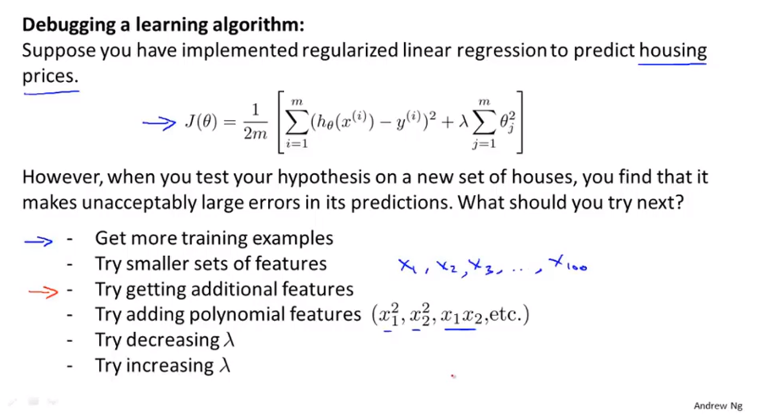
Chapter 11

Slide 3
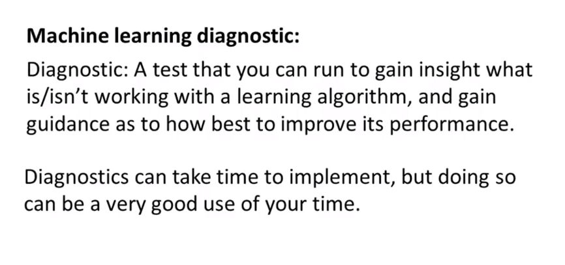
Chapter 11
Which will often give you insight as to what are promising things to try to improve a learning algorithm’s performance.
Take time to implement and can sometimes take quite a lot of time to implement and understand but doing so can be very good use of your time when you are developing learning algorithms because they can often save you from spending many months pursuing an avenue that you could have found out much earlier just was not going to be fruitful.

Slide 4
Chapter 11
Advice for applying machine learning
Evaluating a hypothesis
Standard technique for evaluating how good a learned hypothesis is
In the next part, we will adopt these ideas to help us doing things like choose what features like the degree polynomial to use with the learning algorithm or choose the regularization parameters
for learning algorithm.

Slide 5
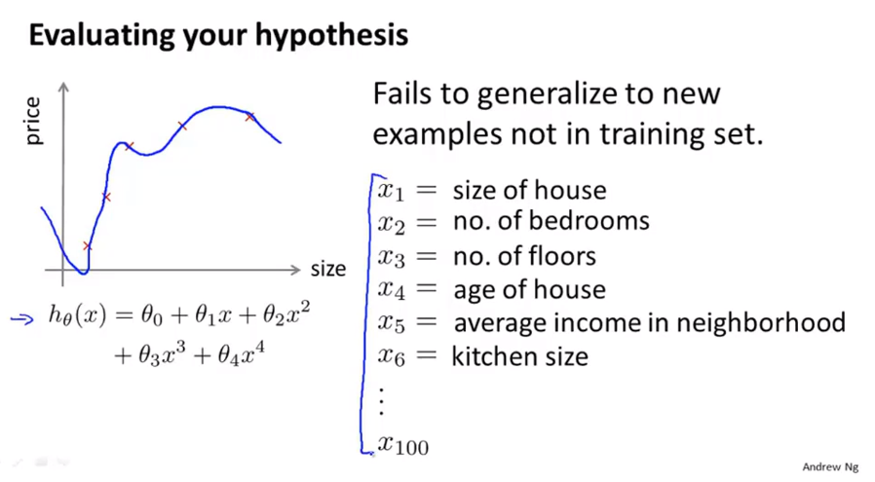
Chapter 11

Slide 6
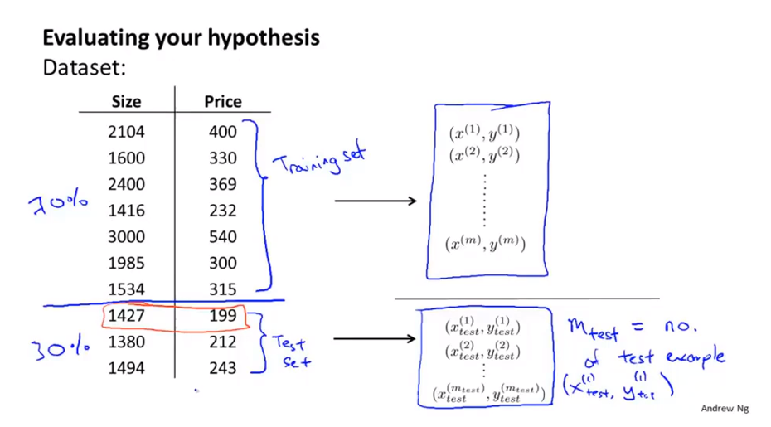
Chapter 11

Slide 7
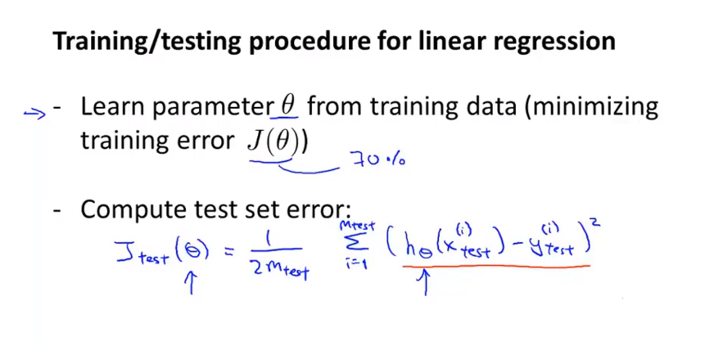
Chapter 11
This is the definition of the test set error if we are using linear regression and using the squared error metric.

Slide 8
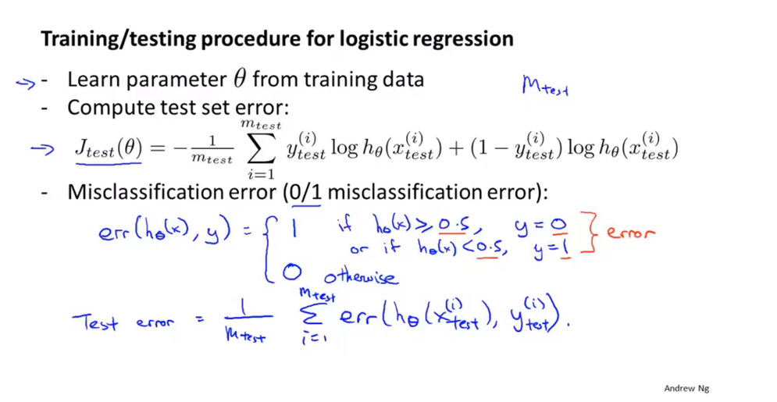
Chapter 11
This is the definition of the test set error using the misclassification error

Slide 9
Chapter 11
Advice for applying machine learning
Model selection and training/validation/test sets
Model selection problem:
Decide what degree of polynomial to fit a data set. So what features to include to give you a learning algorithm.
Choose the regularization parameter lambda for learning algorithm.
Switch data into what we discover is called the train, validation, and test sets.

Slide 10
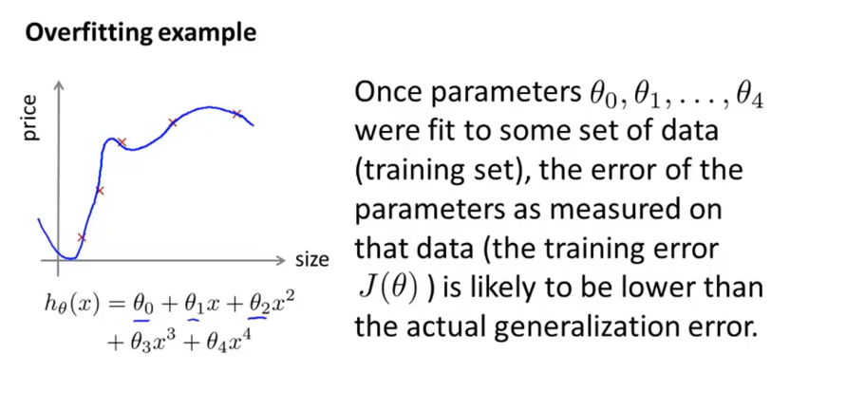
Chapter 11
Overfitting: A learning algorithm fits a training set well, that does not mean it’s a good hypothesis
Training set’s error is not a good predictor for how well the hypothesis will do no new example.
The error of your hypothesis is measured on that same data set, such as the training error, that’s unlikely to be a good estimate of your actual generalization error, that is how well the hypothesis will generalize to new example.

Slide 11
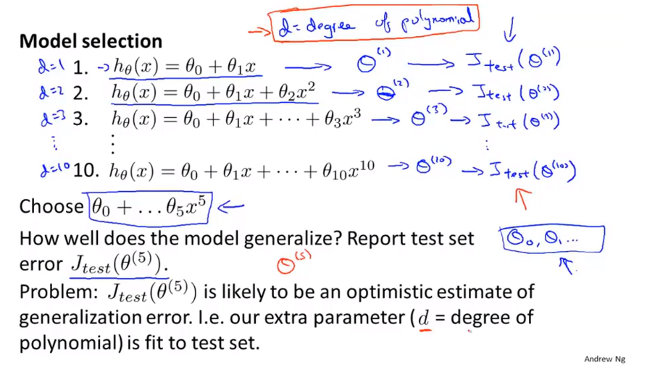
Chapter 11
We fit this parameter d to the test set and by having fit the parameter to the test set, this means that the performance of the hypothesis on that test set may not be a fair estimate of how well the hypothesis is likely to do no examples we haven’t seen before.

Slide 12
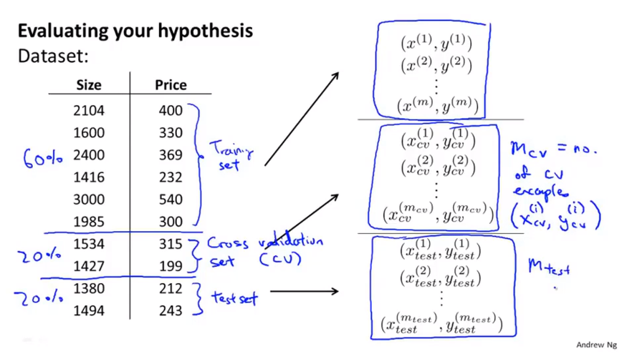
Chapter 11
cv: cross validation

Slide 13
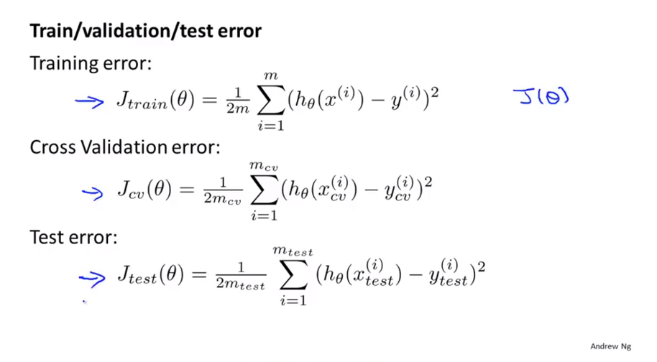
Chapter 11

Slide 14
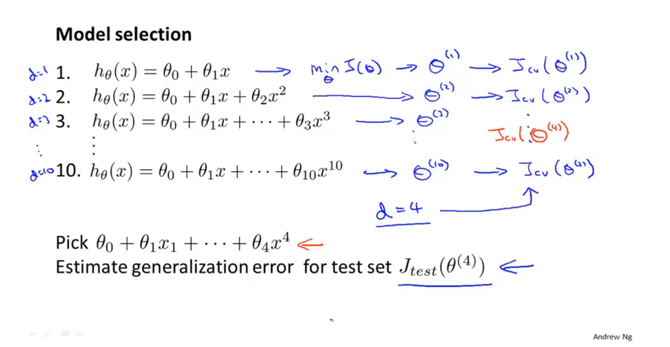
Chapter 11
We’ve now saved away the test set and we can use the test set to measure , or to estimate the generalization error of the model that was selected by the algorithm,.

Slide 15
Chapter 11
Advice for applying machine learning
Diagnosing bias vs. variance
High bias problem: underfitting
High variance: overfitting

Slide 16
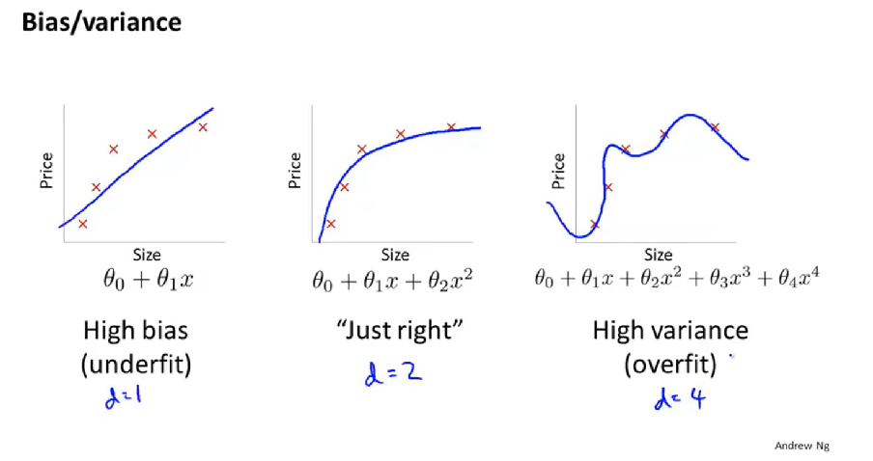
Chapter 11

Slide 17
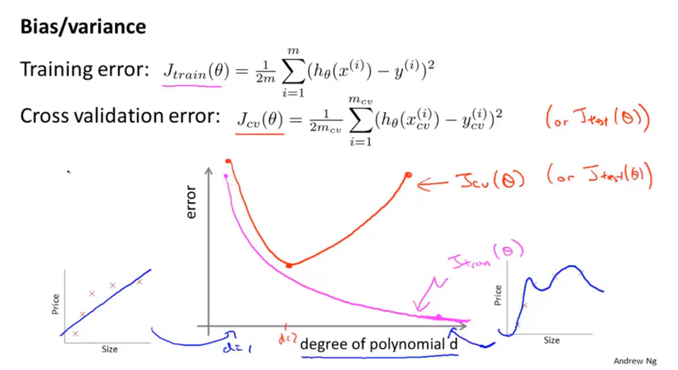
Chapter 11

Slide 18
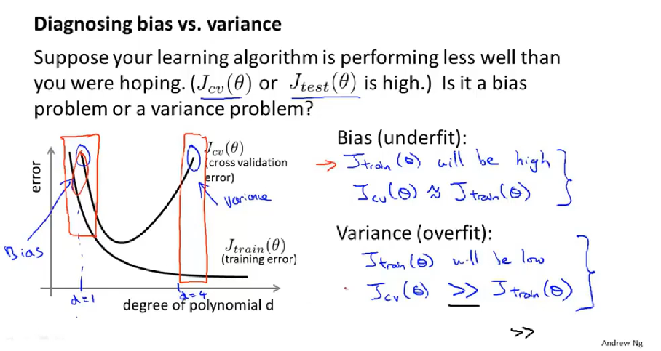
Chapter 11

Slide 19
Chapter 11
Advice for applying machine learning
Regularization and bias/variance
How bias and variance interact with and is effected by the regularization of your learning algorithm.

Slide 20
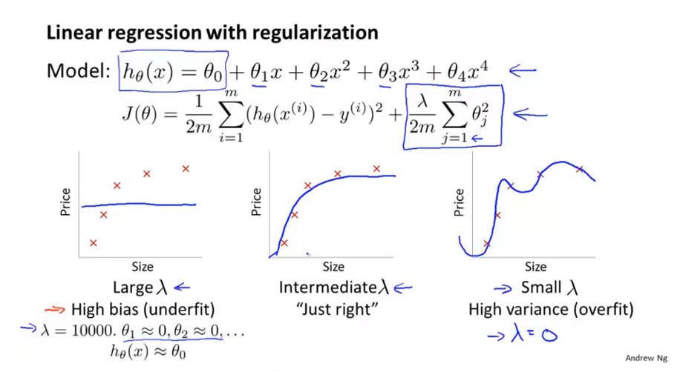
Chapter 11

Slide 21
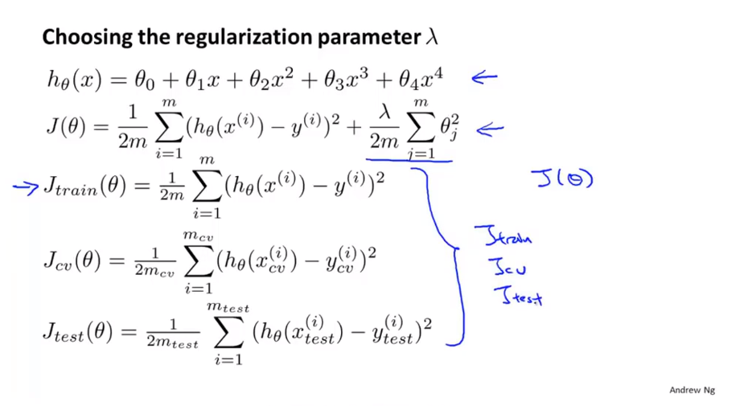
Chapter 11
J_train\J_cv \J_test are just the average squared error or one half of the average squared error on my training validation and test sets without extra regularization term.

Slide 22
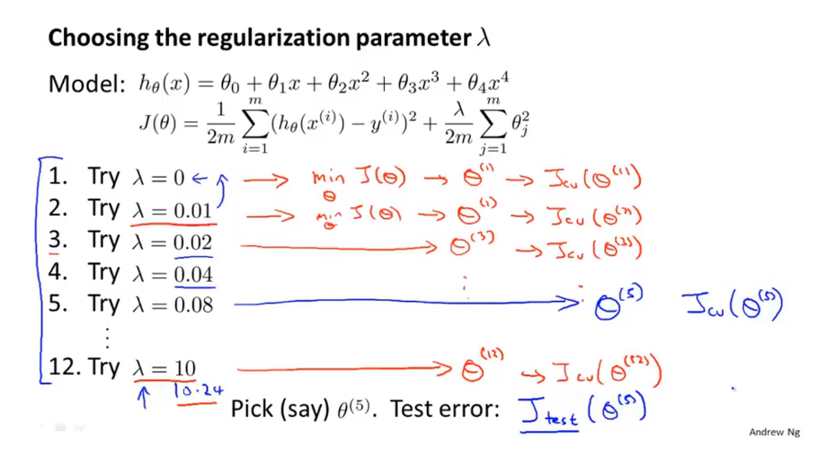
Chapter 11

Slide 23
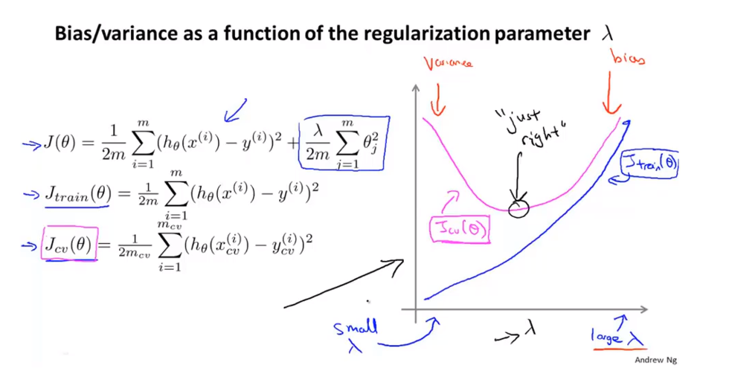
Chapter 11
Some intermedia value of regularization parameter lambda is just right.

Slide 24
Chapter 11
Advice for applying machine learning
Learning curves
Learning curves is useful if you want to sanity check that your algorithm is working correctly, or if you want to improve the performance of the algorithm.
It can be used to diagnose if a physical learning algorithm maybe suffering from bias, variance problem or a bit of both.

Slide 25
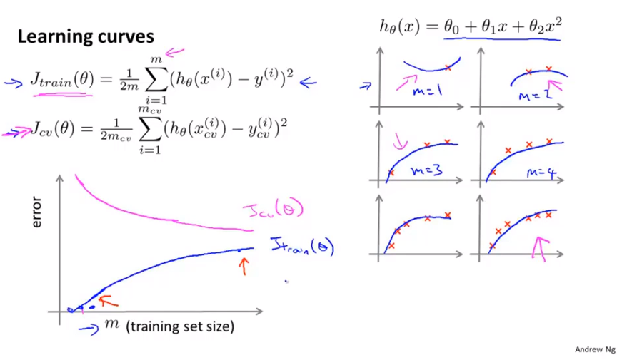
Chapter 11

Slide 26
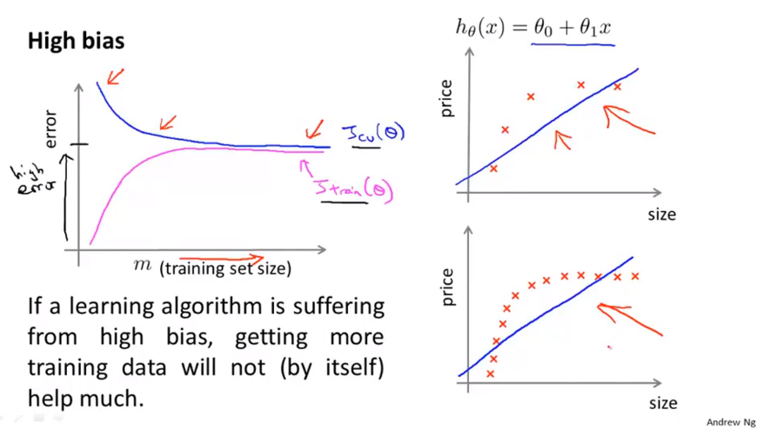
Chapter 11
If the learning algorithm has high bias just give me a lot more training data. That doesn’t actually help you get much lower cross validation error or test error.
So knowing your algorithm is suffering from high bias seems like a useful thing to know because this can prevent you from wasting a lot of time collecting more training data where it might just not end up being helpful.

Slide 27
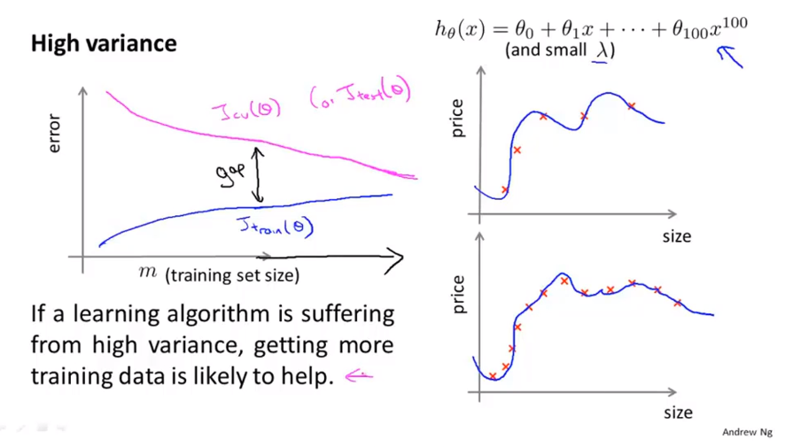
Chapter 11
In the high variance setting, getting more training data is indeed likely to help.
It maybe worthwhile if you can go and get more training data.

Slide 28
Chapter 11
Advice for applying machine learning
Deciding what to try next (revisited)

Slide 29
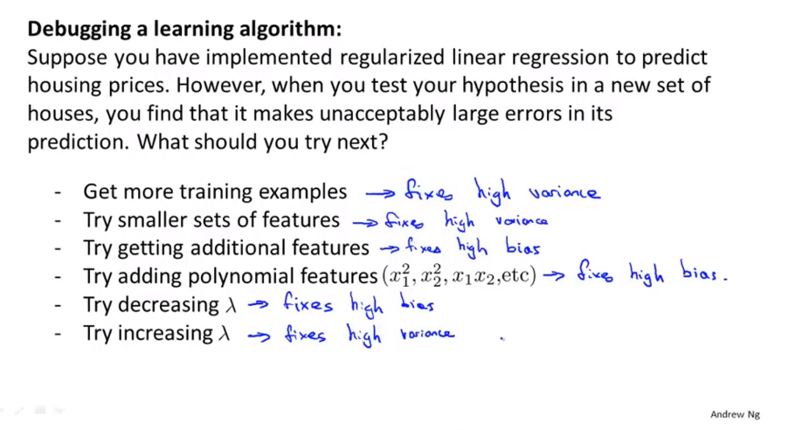
Chapter 11

Slide 30
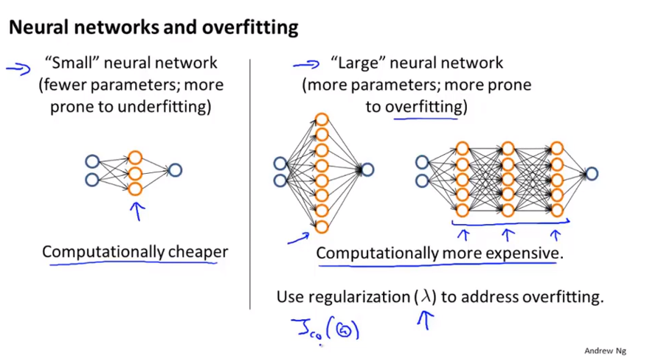
Chapter 11

Slide 31
Chapter 11
Note of the above slides:
Usually, using a single hidden layer is a reasonable default, but if you want to choose the number of hidden layers, one other thing you can try is find yourself a training cross validation and test set split and try training neural networks with one hidden layer or two hidden layers or three hidden layers and see which of those neural network perform best on the cross validation sets.
You take your three neural networks with one, two and three hidden layers, and compute the cross validation error of J_cv of all of them and use that to select which of these is you think the best neural network.

